Slide 1
Sessions 1 & 2:
What is sociological thinking? What do sociologists do?
主讲导师：严雪文
Notes:
说明：
斜体灰色字是需要填写部分
粉色字体是说明
1

Slide 2
Course plan
https://github.com/XueWenSYan/Intro_to_sociology
The syllabus & textbooks
Additional readings
Assignments
Class activities

Slide 3
Part 1: The Sociological Perspective
1
What is sociological thinking?
2
A brief overview of the history of sociology
Notes:
3

Slide 4
1
What is sociological thinking?
What do sociologists study?
Group-level variations across populations (observe “patterns”)
Social/contextual/group-level causes of social phenomena (explain)
Meanings that individuals attach to their behavior (mechanisms/social processes)

Slide 5
1
What is sociological thinking?
Examples
Do people commit suicide because of their idiosyncratic (独特的) miseries or psychological dispositions? [social integration/cohesion, social regulation]
Durkheim (1897) Suicide
Do children get admitted to Ivy League schools purely because of their merit?
Varying opportunity of schooling among children of different socioeconomic backgrounds
Could biology and genetics tell us everything about mortality and health problems?
Social gradient of health
Conrad and Barker (2010), “The Social Construction of Illness: Key Insights and Policy Implications”
Illness embedded with嵌入在 cultural meaning; individuals’ experience and understanding of their illness; medical knowledge developed by claims-makers and interested parties
PTSD

Slide 6
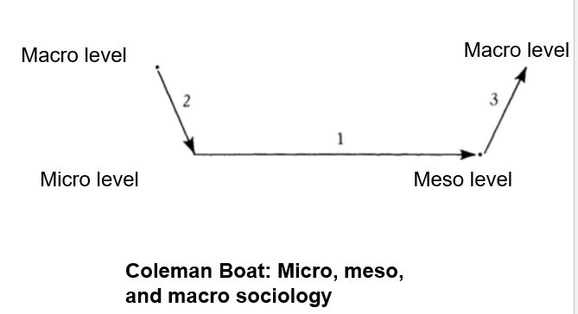

Slide 7
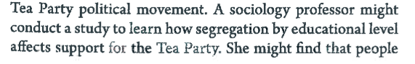
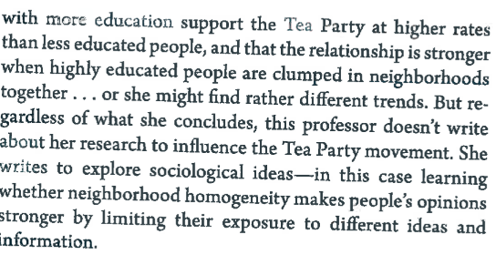
1
What is sociological thinking?
Learning through reading
Questions:
What is the research question of the sociologist?
What are her findings?
How does her research relate to the general principles of sociological thinking?
Why is “to influence the Tea Party Movement” not the goal of her research?

Slide 8


1
What is sociological thinking?
The sociological imagination enables us to grasp history and biography and the relations between the two within society. (Mills 1959) The Sociological Imagination
Sociology is concerned with the “interpretive understanding of social action in order thereby to arrive at a causal explanation of its course and effects. […] (Weber, 1922 Economy and Society, p4) 韦伯，《社会学的基本概念》 Calvinism methodism, science as a vocation, politics as a vocation
Notes:
Action is social insofar as, by virtue of the subjective meaning attached to it by the acting individual (or individuals), it takes account of the behaviour of others and is thereby oriented in its course.”

Slide 9
1
What counts as
sociological research?
More practicalities
Describing a phenomenon/noting an observation
Explaining a phenomenon/event
Relationship between explanandum (dependent variable) and explanans (independent variable) + social mechanism/process

Slide 10
The next question:
A brief history of sociology
Notes:
Show the student how to use google citation

Slide 11
1
The Sociology of Sociology
The history: What is the goal of sociology for the “founding fathers” of the discipline?
Auguste Comte (1798 -1857)
Karl Marx (1818 -1883)
Durkheim (1858 – 1917)
Georg Simmel (1858-1918)
Max Weber (1864 – 1920)
The present: What does theory mean in contemporary sociology?
The critical: What are the understandings of theory outside of the “canon”?
Notes:
Show the student how to use google citation

Slide 12
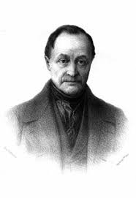

Auguste Comte: France (1798 -1857)
First and most influential work: The Course in Positive Philosophy (1855)
Coined the name “Sociology” (sociologie in French)
The scientific study of human society
Scientific = positivist
Mathematics vs sociology?
Generalizability
Empirical complexity
Legacy: Positivist sociology (e.g., Durkheim)
Publishing time: 1830-1842

Slide 13

Karl Marx: Germany (1818 -1883)
A specter is haunting Europe—the specter of Communism. (Communist Manifesto 1848)
The history of all previous societies has been the history of class struggles. (Communist Manifesto 1848)
The ideas of the ruling class are in every epoch the ruling ideas. (Germany Ideology 1845)
The first premise of all human history is, of course, the existence of living human individuals. (Germany Ideology 1845)
A commodity is therefore a mysterious thing […] because the relation of the producers to the sum total of their own labour is presented to them as a social relation, existing not between themselves, but between the products of their labour. (Capital, Volume I 1867)

Slide 14

Karl Marx: Germany (1818 -1883)
Social theory ⬄ Political project
The conflict perspective
The dialectic of class antagonism as the engine of history
Capitalism specifically: bourgeoisie vs proletariat
The bourgeoisie controls:
Means of production (materially)
Ideology or “ hegemony” (culturally, see also Gramsci)
The alienation and exploitation of workers (proletariats)
Fetishism of commodity
Historical materialism
No understanding of society without resorting to the dominant social relationships in that historical context
Legacy
Communist revolutions/countries
Conflict perspective – a main paradigm in sociology
Critical theory/critique of capitalism (Frankfurt School)
Notes:
A specter is haunting Europe—the specter of Communism. (Communist Manifesto 1848)
The history of all previous societies has been the history of class struggles. (Communist Manifesto 1848)
The ideas of the ruling class are in every epoch the ruling ideas. (Germany Ideology 1845)
The first premise of all human history is, of course, the existence of living human individuals. (Germany Ideology 1845)
A commodity is therefore a mysterious thing […] because the relation of the producers to the sum total of their own labour is presented to them as a social relation, existing not between themselves, but between the products of their labour. (Capital, Volume I 1867
Conflict part: most sociologists today more or less adhere to it, although they may detach themselves from the tinge of Marxism.
Historical materialism: often equated with Marxism

Slide 15

Max Weber: Germany 1864 – 1920
The Protestant Ethic and the Spirit of Capitalism (translated by Parsons 1930)
Origin of capitalism
Politics as a Vocation (1919)
State: monopoly over the use of legitimate coercive power in a given territory
Three types of authority: traditional, charismatic, legal
Ideal-type
Theoretical constructs that describes the course of social phenomena while taking account subject meanings
Used for comparison between ideal-type and the observed reality
Class, Status, Party in Economy and Society (1922)
Three-component theory of social stratification
Class: economic, position in the labor market
Status: prestige and honour; members of a status group are accepted as equals
财富、声望、权力

Slide 16
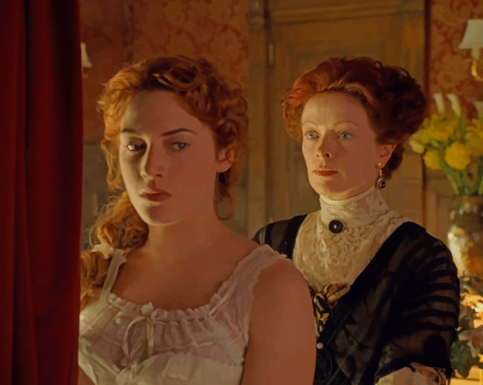
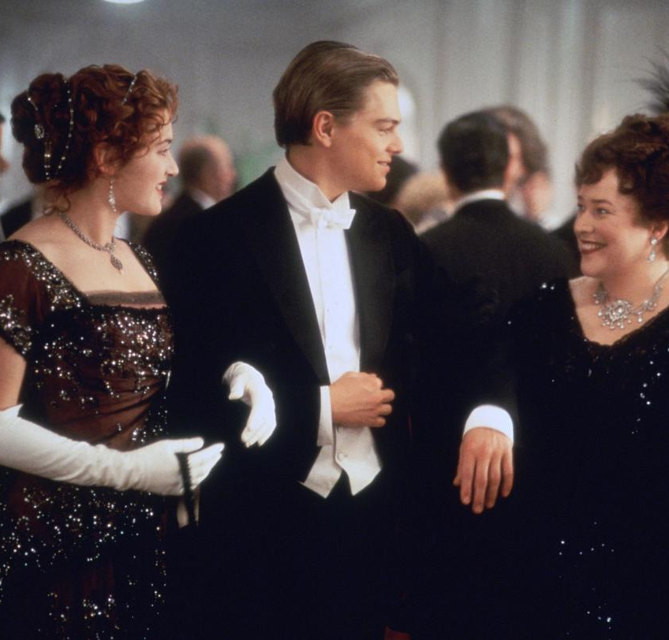

Slide 17
Question
Compare Marx and Weber’s theories of class?

Slide 18
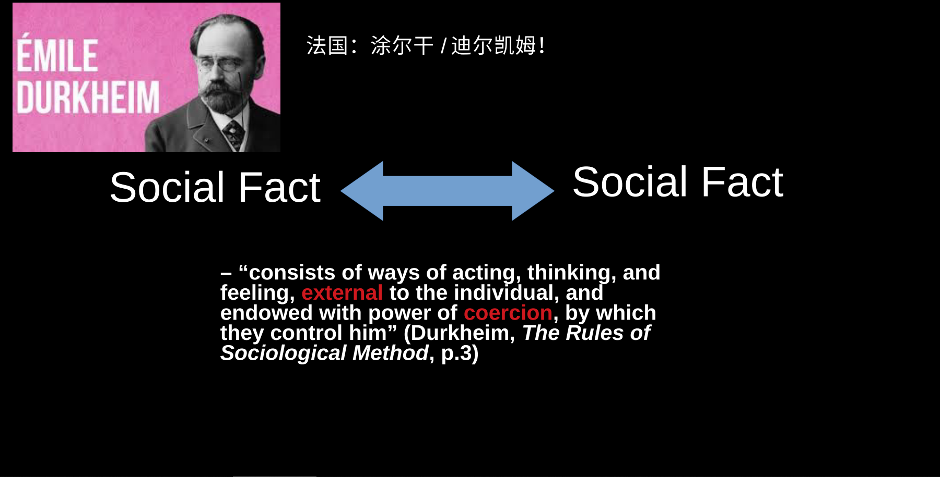
1858-1917

Slide 19
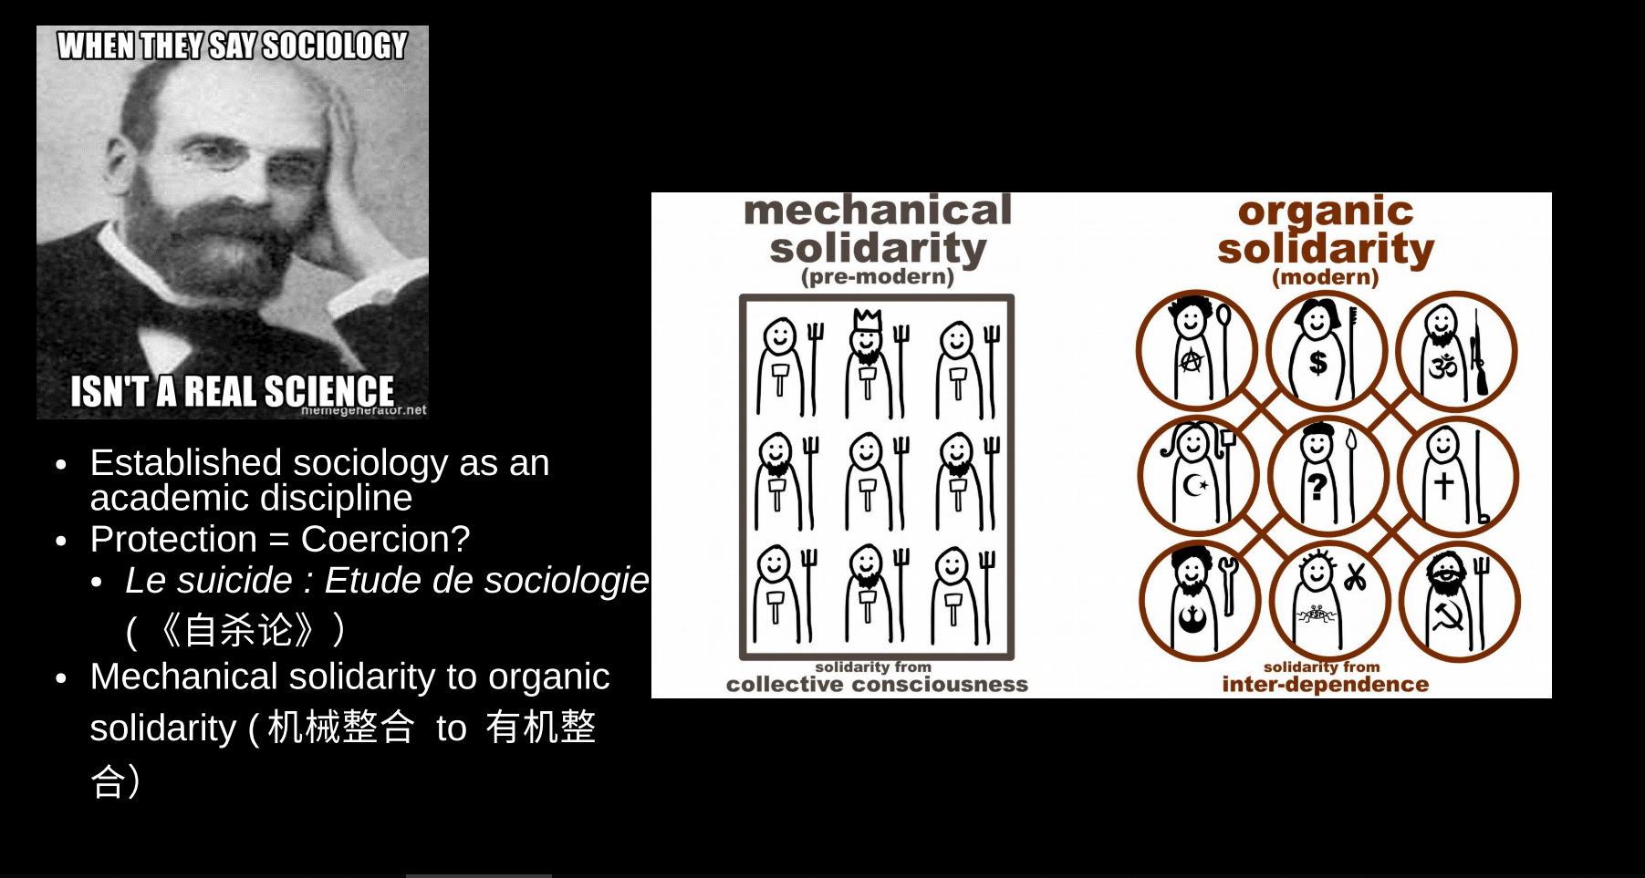
1897
(The Division of Labor in Society 1893)

Slide 20
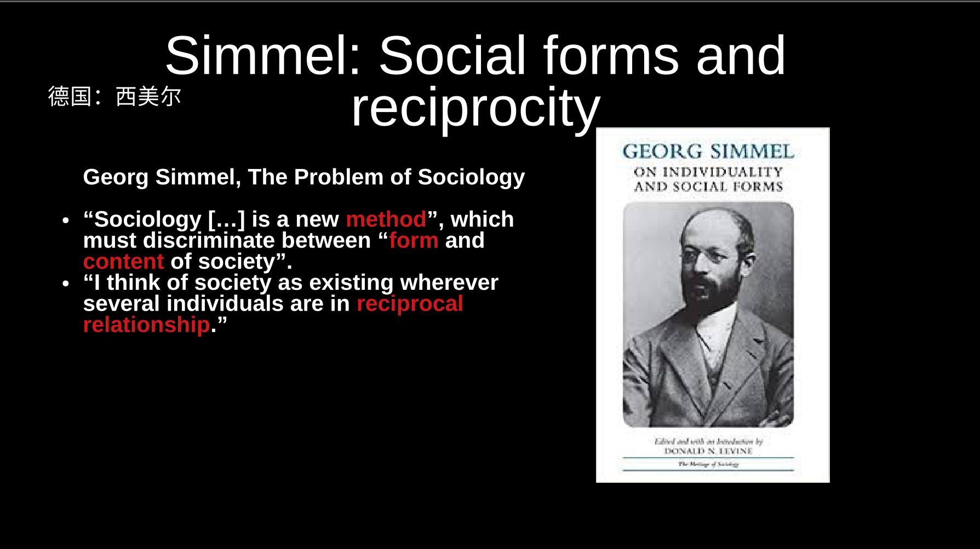

Slide 21
2
Contemporary sociological theory
Merton’s theory of middle range and analytical sociology
Mills’ sociological imagination
General Rule of Thumb
Notes:
Show the student how to use google citation

Slide 22
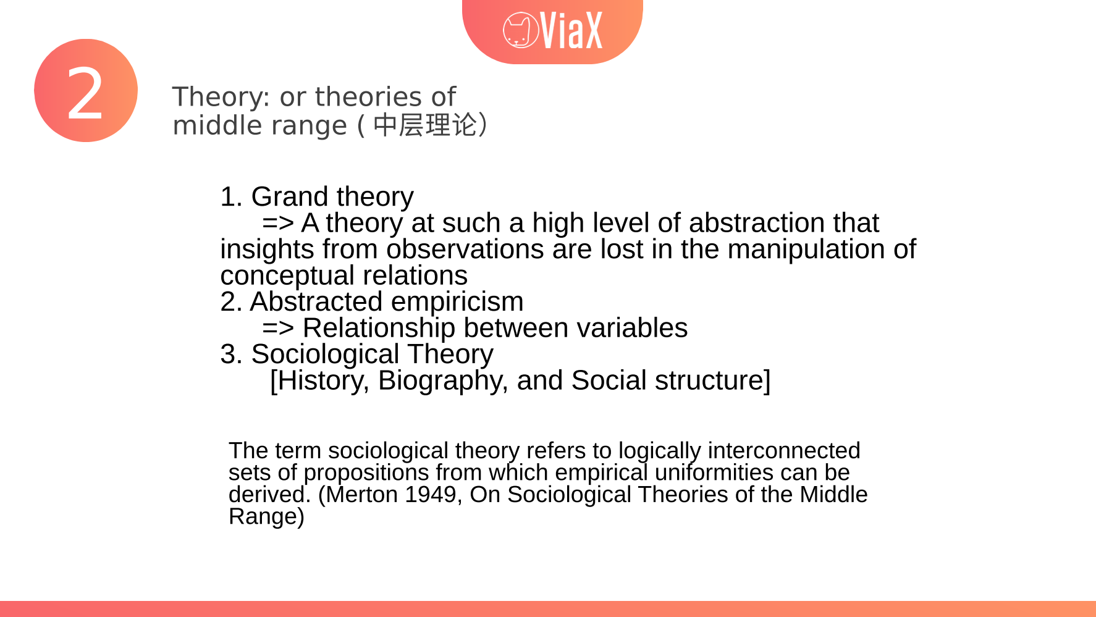


Slide 23
2
Merton: Theories of middle range
Reference:
Merton, R. K. (1949), On sociological theories of the middle range, in Merton, R.K., Social theory and social structure. Simon and Schuster.
“The term sociological theory refers to logically interconnected sets of propositions from which empirical uniformities can be derived.” (Merton 1949)
Neither “grand theory” nor “abstract empiricism” in C. Wright Mills’s term.
“social mechanisms [are] the social processes [that have] designated consequences for designated parts of the social structure” (Merton 1949)
Notes:
Show the student how to use google citation

Slide 24
1
Merton: Theories of middle range
Examples of social mechanisms
Reference group or relative deprivation
Cumulative advantage (or Matthew effect)
Residential segregation
Self-fulfilling prophecy

